Slide 1
Normalization
Prof. X

Slide 2
Outline
Features of Good Relational Design
Functional Dependencies
Decomposition Using Functional Dependencies
Normal Forms
Functional Dependency Theory
Algorithms for Decomposition using Functional Dependencies

Slide 3
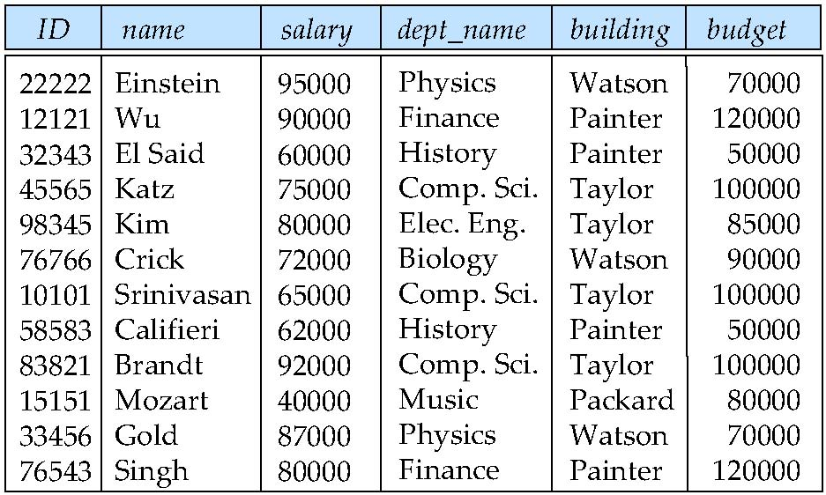
Features of Good Relational Designs
Suppose we combine instructor and department into in_dep, which represents the natural join on the relations instructor and department
There is repetition of information
Need to use null values (if we add a new department with no instructors)

Slide 4
A Combined Schema Without Repetition
Not all combined schemas result in repetition of information
Consider combining relations
sec_class(sec_id, building, room_number) and
section(course_id, sec_id, semester, year)
into one relation
section(course_id, sec_id, semester, year, building, room_number)
No repetition in this case

Slide 5
Decomposition
The only way to avoid the repetition-of-information problem in the in_dep schema is to decompose it into two schemas – instructor and department schemas.
Not all decompositions are good. Suppose we decompose
employee(ID, name, street, city, salary)
into
employee1 (ID, name)
employee2 (name, street, city, salary)
The problem arises when we have two employees with the same name
The next slide shows how we lose information -- we cannot reconstruct the original employee relation -- and so, this is a lossy decomposition.

Slide 6
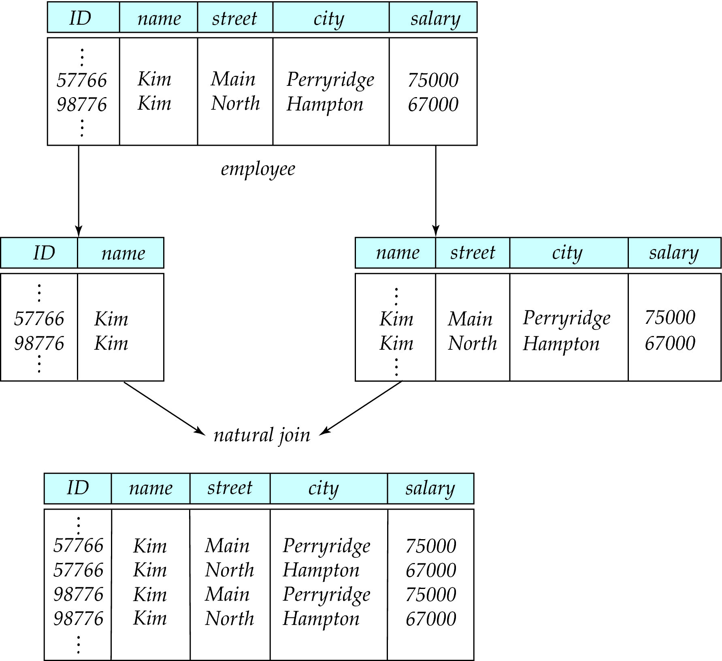
A Lossy Decomposition

Slide 7
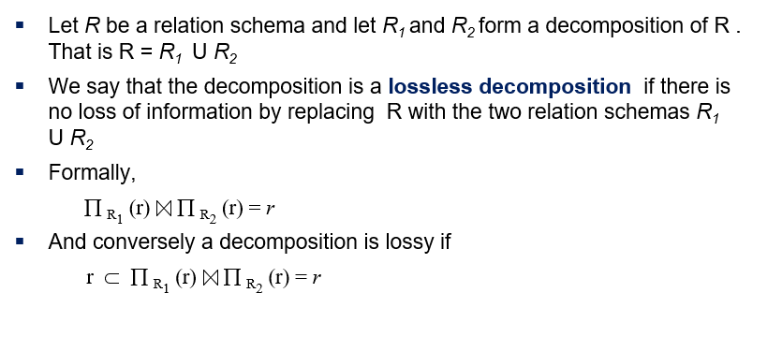
Lossless Decomposition

Slide 8
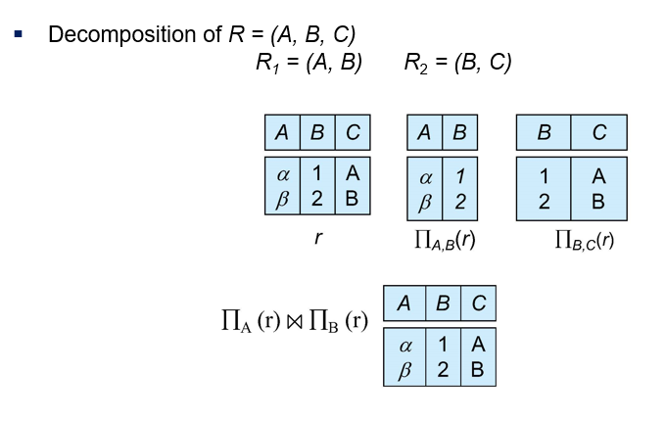
Example of Lossless Decomposition

Slide 9
Normalization Theory
Decide whether a particular relation R is in “good” form.
In the case that a relation R is not in “good” form, decompose it into set of relations {R₁, R₂, ..., R_{n}} such that
Each relation is in good form
The decomposition is a lossless decomposition
Our theory is based on:
Functional dependencies
Multivalued dependencies

Slide 10
Functional Dependencies
There are usually a variety of constraints (rules) on the data in the real world.
For example, some of the constraints that are expected to hold in a university database are:
Students and instructors are uniquely identified by their ID.
Each student and instructor has only one name.
Each instructor and student is (primarily) associated with only one department.
Each department has only one value for its budget, and only one associated building.

Slide 11
Functional Dependencies (Cont.)
An instance of a relation that satisfies all such real-world constraints is called a legal instance of the relation;
A set of legal instances of a database is one where all the relation instances are legal instances
Constraints on the set of legal relations require that the value for a certain set of attributes determines uniquely the value for another set of attributes.
A functional dependency is a generalization of the notion of a key.

Slide 12
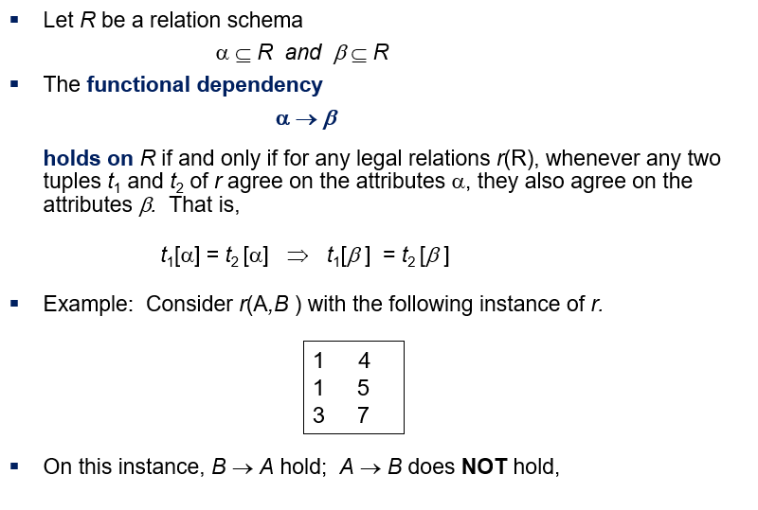
Functional Dependencies Definition

Slide 13
Closure of a Set of Functional Dependencies
Given a set of functional dependencies F, there are certain other functional dependencies that are logically implied by F.
If A → B and B → C, then we can infer that A → C
etc.
The set of all functional dependencies logically implied by F is the closure of F.
We denote the closure of F by F⁺.
Example: Student (ID, Name, Total_Creds, Department_Name)
F = {ID}
What is F⁺

Slide 14
Keys and Functional Dependencies
K is a superkey for relation schema R if and only if K → R
K is a candidate key for R if and only if
K → R, and
for no α ⊂ K, α → R
Functional dependencies allow us to express constraints that cannot be expressed using superkeys. Consider the schema:
in_dep (ID, name, salary, dept_name, building, budget ).
We expect these functional dependencies to hold:
dept_name→ building
ID → building
but would not expect the following to hold:
dept_name → salary

Slide 15
Use of Functional Dependencies
We use functional dependencies to:
To test relations to see if they are legal under a given set of functional dependencies.
If a relation r is legal under a set F of functional dependencies, we say that r satisfies F.
To specify constraints on the set of legal relations
We say that F holds on R if all legal relations on R satisfy the set of functional dependencies F.
Note: A specific instance of a relation schema may satisfy a functional dependency even if the functional dependency does not hold on all legal instances.
For example, a specific instance of instructor may, by chance, satisfy name → ID.

Slide 16
Trivial Functional Dependencies
A functional dependency is trivial if it is satisfied by all instances of a relation
Example:
ID, name → ID
name → name
In general, α → β is trivial if β ⊆ α

Slide 17
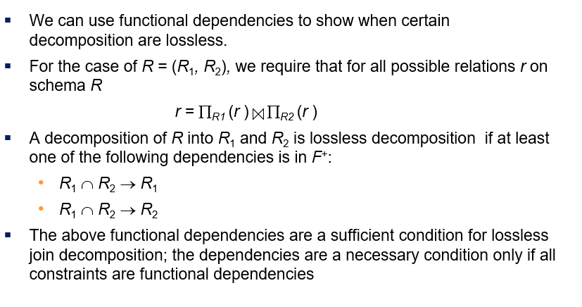
Lossless Decomposition

Slide 18
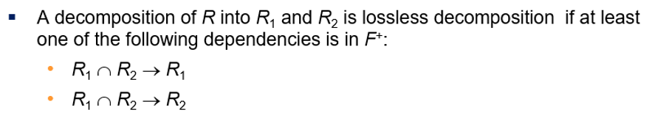
Example
R = (A, B, C) F = {A → B, B → C)
R₁ = (A, B), R₂ = (B, C)
Lossless decomposition:
R₁ ∩ R₂ = {B} and B → BC
R₁ = (A, B), R₂ = (A, C)
Lossless decomposition:
R₁ ∩ R₂ = {A} and A → AB
Note:
B → BC
is a shorthand notation for
B → {B, C}

Slide 19
Dependency Preservation
Testing functional dependency constraints each time the database is updated can be costly
It is useful to design the database in a way that constraints can be tested efficiently.
If testing a functional dependency can be done by considering just one relation, then the cost of testing this constraint is low
A functional dependency X → Y is preserved in a relation R if R contains all the attributes of X and Y .
A functional dependency can therefore be checked by accessing only R.
Consider the following scenario:
decompose R(A, B, C, D) under F = {A → B, B → C}.
Our decomposition resulted in: R1(AB), R2(AC), and R3(AD)
A → B is preserved in R1.
B → C is not preserved in any relation.

Slide 20
Dependency Preservation Example
Consider a schema:
dept_advisor(s_ID, i_ID, department_name)
With function dependencies:
i_ID → dept_name
s_ID, dept_name → i_ID
In the above design we are forced to repeat the department name once for each time an instructor participates in a dept_advisor relationship.
To fix this, we need to decompose dept_advisor
Any decomposition will not include all the attributes in
s_ID, dept_name → i_ID
Thus, the composition NOT be dependency preserving

Slide 21
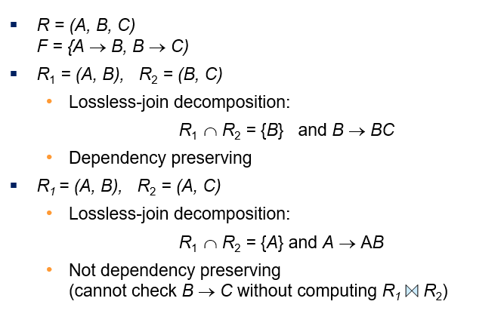
Example

Slide 22
Boyce-Codd Normal Form
A relation schema R is in BCNF with respect to a set F of functional dependencies if for all functional dependencies in F⁺ of the form
α → β
where α ⊆ R and β ⊆ R, at least one of the following holds:
α → β is trivial (i.e., β ⊆ α)
α is a superkey for R

Slide 23
Boyce-Codd Normal Form (Cont.)
Example schema BCNF or NOT?
in_dep (ID, name, salary, dept_name, building, budget )
because :
dept_name→ building, budget
holds on in_dep
but
dept_name is not a superkey
When decompose in_dept into instructor and department
instructor is in BCNF
department is in BCNF

Slide 24
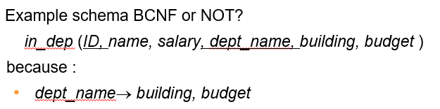
Decomposing a Schema into BCNF
Let R be a schema R that is not in BCNF. Let α →β be the FD that causes a violation of BCNF.
We decompose R into:
(α U β )
( R - ( β - α ) )
In our example of in_dep,
α = dept_name
β = building, budget
and in_dep is replaced by
(α U β ) = ( dept_name, building, budget )
( R - ( β - α ) ) = ( ID, name, dept_name, salary )

Slide 25
BCNF and Dependency Preservation
It is not always possible to achieve both BCNF and dependency preservation
Consider a schema:
dept_advisor(s_ID, i_ID, department_name)
With function dependencies:
i_ID → dept_name
s_ID, dept_name → i_ID
dept_advisor is not in BCNF
i_ID is not a superkey.
Any decomposition of dept_advisor will not include all the attributes in
s_ID, dept_name → i_ID
Thus, the composition is NOT be dependency preserving

Slide 26
Third Normal Form
A relation schema R is in third normal form (3NF) if for all:
α → β in F⁺
at least one of the following holds:
α → β is trivial (i.e., β ∈ α)
α is a superkey for R
Each attribute A in β – α is contained in a candidate key for R.
(NOTE: each attribute may be in a different candidate key)
If a relation is in BCNF it is in 3NF (since in BCNF one of the first two conditions above must hold).
Third condition is a minimal relaxation of BCNF to ensure dependency preservation (will see why later).

Slide 27
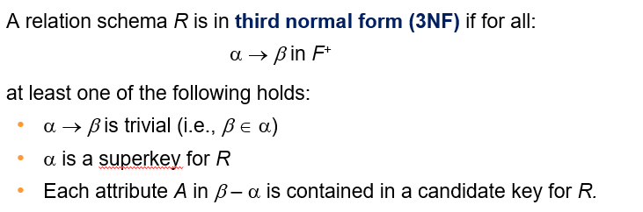
3NF Example
Consider a schema:
dept_advisor(s_ID, i_ID, dept_name)
With function dependencies:
i_ID → dept_name
s_ID, dept_name → i_ID
Two candidate keys = {s_ID, dept_name}, {s_ID, i_ID }
We have seen before that dept_advisor is not in BCNF
R, however, is in 3NF
s_ID, dept_name is a superkey
i_ID → dept_name and i_ID is NOT a superkey, but:
{ dept_name} – {i_ID } = {dept_name } and
dept_name is contained in a candidate key

Slide 28
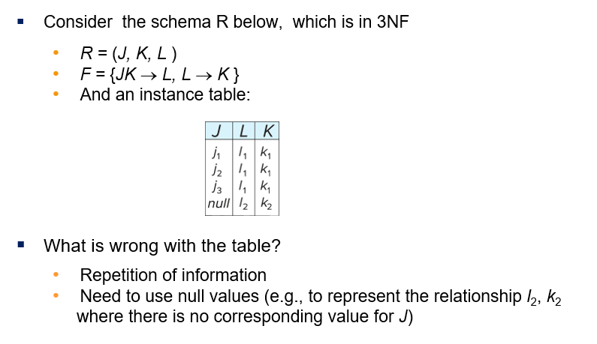
Redundancy in 3NF

Slide 29
Comparison of BCNF and 3NF
Advantages to 3NF over BCNF. It is always possible to obtain a 3NF design without sacrificing losslessness or dependency preservation.
Disadvantages to 3NF.
We may have to use null values to represent some of the possible meaningful relationships among data items.
There is the problem of repetition of information.

Slide 30
Goals of Normalization
Let R be a relation scheme with a set F of functional dependencies.
Decide whether a relation scheme R is in “good” form.
In the case that a relation scheme R is not in “good” form, need to decompose it into a set of relation scheme {R₁, R₂, ..., R_{n}} such that:
Each relation scheme is in good form
The decomposition is a lossless decomposition
Preferably, the decomposition should be dependency preserving.

Slide 31
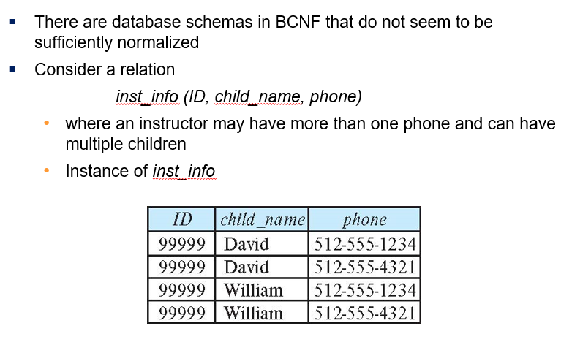
How good is BCNF?

Slide 32
How good is BCNF? (Cont.)
There are no non-trivial functional dependencies and therefore the relation is in BCNF
Insertion anomalies – i.e., if we add a phone 981-992-3443 to 99999, we need to add two tuples
(99999, David, 981-992-3443) (99999, William, 981-992-3443)

Slide 33
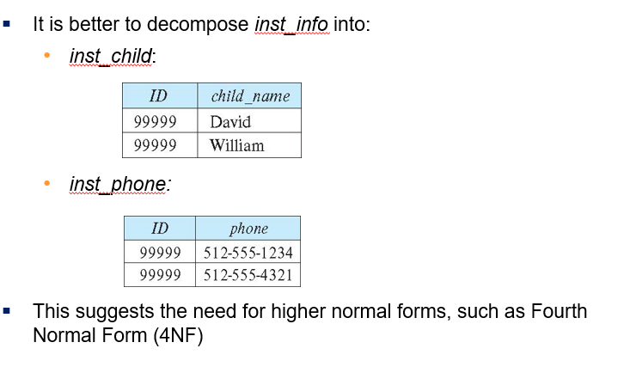
Higher Normal Forms

Slide 34
Design Goals
Goal for a relational database design is:
BCNF.
Lossless join.
Dependency preservation.
If we cannot achieve this, we accept one of
Lack of dependency preservation
Redundancy due to use of 3NF

Slide 35
Functional-Dependency Theory
We now consider the formal theory that tells us which functional dependencies are implied logically by a given set of functional dependencies.
We then develop algorithms to generate lossless decompositions into BCNF and 3NF
We then develop algorithms to test if a decomposition is dependency-preserving

Slide 36
Closure of a Set of Functional Dependencies
Given a set F set of functional dependencies, there are certain other functional dependencies that are logically implied by F.
If A → B and B → C, then we can infer that A → C
etc.
The set of all functional dependencies logically implied by F is the closure of F.
We denote the closure of F by F⁺.

Slide 37
Closure of a Set of Functional Dependencies
We can compute F⁺, the closure of F, by repeatedly applying Armstrong’s Axioms:
Reflexive rule: if β ⊆ α, then α → β
Augmentation rule: if α → β, then γ α → γ β
Transitivity rule: if α → β, and β → γ, then α → γ
These rules are
Sound -- generate only functional dependencies that actually hold, and
Complete -- generate all functional dependencies that hold.

Slide 38
Example of F⁺
R = (A, B, C, G, H, I) F = { A → B A → C CG → H CG → I B → H}
Some members of F⁺
A → H
by transitivity from A → B and B → H
AG → I
by augmenting A → C with G, to get AG → CG and then transitivity with CG → I
CG → HI
by augmenting CG → I to infer CG → CGI,
and augmenting of CG → H to infer CGI → HI,
and then transitivity

Slide 39
Closure of Functional Dependencies (Cont.)
Additional rules:
Union rule: If α → β holds and α → γ holds, then α → β γ holds.
Decomposition rule: If α → β γ holds, then α → β holds and α → γ holds.
Pseudotransitivity rule:If α → β holds and γ β → δ holds, then α γ → δ holds.
The above rules can be inferred from Armstrong’s axioms.

Slide 40
Procedure for Computing F⁺
To compute the closure of a set of functional dependencies F:
F ⁺ = F repeat for each functional dependency f in F⁺ apply reflexivity and augmentation rules on f add the resulting functional dependencies to F ⁺ for each pair of functional dependencies f₁and f₂ in F ⁺ if f₁ and f₂ can be combined using transitivity then add the resulting functional dependency to F ⁺ until F ⁺ does not change any further

Slide 41
Closure of Attribute Sets
Given a set of attributes α, define the closure of α under F (denoted by α⁺) as the set of attributes that are functionally determined by α under F
Algorithm to compute α⁺, the closure of α under F
result := α; while (changes to result) do for each β → γ in F do begin if β ⊆ result then result := result ∪ γ end

Slide 42
Example of Attribute Set Closure
R = (A, B, C, G, H, I)
F = {A → B A → C CG → H CG → I B → H}
(AG)⁺
1. result = AG
2. result = ABCG (A → C and A → B)
3. result = ABCGH (CG → H and CG ⊆ AGBC)
4. result = ABCGHI (CG → I and CG ⊆ AGBCH)
Is AG a candidate key?
Is AG a super key? YES
Is any subset of AG a superkey?

Slide 43
Uses of Attribute Closure
There are several uses of the attribute closure algorithm:
Testing for superkey:
To test if α is a superkey, we compute α^{+,} and check if α⁺ contains all attributes of R.
Testing functional dependencies
To check if a functional dependency α → β holds (or, in other words, is in F⁺), just check if β ⊆ α⁺.
That is, we compute α⁺ by using attribute closure, and then check if it contains β.
Is a simple and cheap test, and very useful
Computing closure of F
For each γ ⊆ R, we find the closure γ⁺, and for each S ⊆ γ⁺, we output a functional dependency γ → S.

Slide 44
Canonical Cover
Suppose that we have a set of functional dependencies F on a relation schema. Whenever a user performs an update on the relation, the database system must ensure that the update does not violate any functional dependencies; that is, all the functional dependencies in F are satisfied in the new database state.
If an update violates any functional dependencies in the set F, the system must roll back the update.
We can reduce the effort spent in checking for violations by testing a simplified set of functional dependencies that has the same closure as the given set.
This simplified set is termed the canonical cover
To define canonical cover we must first define extraneous attributes.
An attribute of a functional dependency in F is extraneous if we can remove it without changing F ⁺

Slide 45
Extraneous Attributes
Removing an attribute from the left side of a functional dependency could make it a stronger constraint.
For example, if we have AB → C and remove B, we get the possibly stronger result A → C. It may be stronger because A → C logically implies AB → C, but AB → C does not, on its own, logically imply A → C
But, depending on what our set F of functional dependencies happens to be, we may be able to remove B from AB → C safely.
For example, suppose that
F = {AB → C, A → D, D → C}
Then we can show that F logically implies A → C, making extraneous in AB → C.

Slide 46
Extraneous Attributes (Cont.)
Removing an attribute from the right side of a functional dependency could make it a weaker constraint.
For example, if we have AB → CD and remove C, we get the possibly weaker result AB → D. It may be weaker because using just AB → D, we can no longer infer AB → C.
But, depending on what our set F of functional dependencies happens to be, we may be able to remove C from AB → CD safely.
For example, suppose that
F = { AB → CD, A → C}
Then we can show that even after replacing AB → CD by AB → D, we can still infer AB → C and thus AB → CD.

Slide 47
Extraneous Attributes
An attribute of a functional dependency in F is extraneous if we can remove it without changing F ⁺
Consider a set F of functional dependencies and the functional dependency α → β in F.
Remove from the left side: Attribute A is extraneous in α if
A ∈ α and
F logically implies (F – {α → β}) ∪ {(α – A) → β}.
Remove from the right side: Attribute A is extraneous in β if
A ∈ β and
The set of functional dependencies
(F – {α → β}) ∪ {α →(β – A)} logically implies F.
Note: implication in the opposite direction is trivial in each of the cases above, since a “stronger” functional dependency always implies a weaker one

Slide 48
Testing if an Attribute is Extraneous
Let R be a relation schema and let F be a set of functional dependencies that hold on R . Consider an attribute in the functional dependency α → β.
To test if attribute A ∈ β is extraneous in β
Consider the set: F' = (F – {α → β}) ∪ {α →(β – A)},
check that α⁺ contains A; if it does, A is extraneous in β
To test if attribute A ∈ α is extraneous in α
Let γ = α – {A}. Check if γ → β can be inferred from F.
Compute γ⁺ using the dependencies in F
If γ⁺ includes all attributes in β then , A is extraneous in α

Slide 49
Examples of Extraneous Attributes
Let F = {AB → CD, A → E, E → C }
To check if C is extraneous in AB → CD, we:
Compute the attribute closure of AB under F' = {AB → D, A → E, E → C}
The closure is ABCDE, which includes CD
This implies that C is extraneous

Slide 50
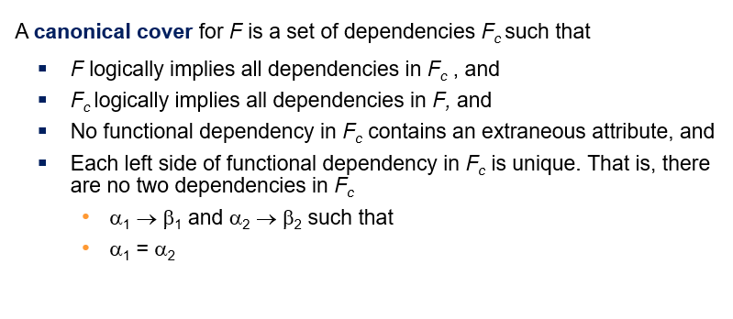
Canonical Cover

Slide 51
Canonical Cover
To compute a canonical cover for F:
repeat
Use the union rule to replace any dependencies in F of the form
α₁ → β₁ and α₁ → β₂ with α₁ → β₁ β₂
Find a functional dependency α → β in F_{c} with an extraneous
attribute either in α or in β
/* Note: test for extraneous attributes done using F_{c,} not F*/
If an extraneous attribute is found, delete it from α → β
until (F_{c} not change
Note: Union rule may become applicable after some extraneous attributes have been deleted, so it has to be re-applied

Slide 52
Example: Computing a Canonical Cover
R = (A, B, C) F = {A → BC B → C A → B AB → C}
Combine A → BC and A → B into A → BC
Set is now {A → BC, B → C, AB → C}
A is extraneous in AB → C
Check if the result of deleting A from AB → C is implied by the other dependencies
Yes: in fact, B → C is already present!
Set is now {A → BC, B → C}
C is extraneous in A → BC
Check if A → C is logically implied by A → B and the other dependencies
Yes: using transitivity on A → B and B → C.
Can use attribute closure of A in more complex cases
The canonical cover is: A → B B → C

Slide 53
Dependency Preservation
Let F be the set of dependencies on schema R and let R₁, R₂ , .., R_{n} be a decomposition of R.
The restriction of F to R_{i} is the set F_{i} of all functional dependencies in F ⁺ that include only attributes of R_{i} .
Let F_{i} be the set of dependencies F ⁺ that include only attributes in R_{i}.
A decomposition is dependency preserving, if
(F₁ ∪ F₂ ∪ … ∪ F_{n} )⁺ = F ⁺
Using the above definition, testing for dependency preservation take exponential time.
Not that if a decomposition is NOT dependency preserving then checking updates for violation of functional dependencies may require computing joins, which is expensive.

Slide 54
Dependency Preservation (Cont.)
Since all functional dependencies in a restriction involve attributes of only one relation schema, it is possible to test such a dependency for satisfaction by checking only one relation.
Note that the definition of restriction uses all dependencies in in F ⁺, not just those in F.
The set of restrictions F₁, F₂ , .. , F_{n} is the set of functional dependencies that can be checked efficiently.

Slide 55
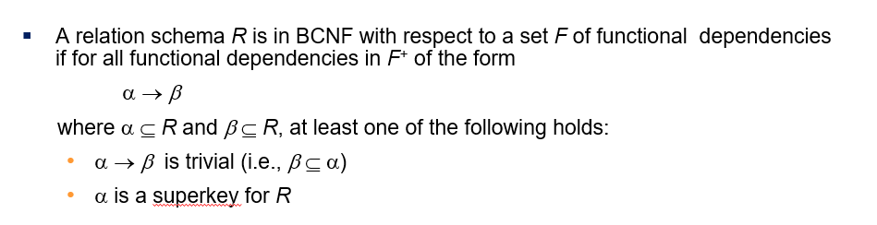
Example
R = (A, B, C ) F = {A → B B → C} Key = {A}
R is not in BCNF
Decomposition R₁ = (A, B), R₂ = (B, C)
R₁ and R₂ in BCNF
Lossless-join decomposition
Dependency preserving

Slide 56
BCNF Decomposition Algorithm
result := {R }; done := false; compute F ⁺; while (not done) do if (there is a schema R_{i} in result that is not in BCNF) then begin let α → β be a nontrivial functional dependency that holds on R_{i} such that α → R_{i} is not in F ⁺, and α ∩ β = ∅; result := (result – R_{i} ) ∪ (R_{i} – β) ∪ (α, β ); end else done := true;
Note: each R_{i} is in BCNF, and decomposition is lossless-join.

Slide 57
Example of BCNF Decomposition
class (course_id, title, dept_name, credits, sec_id, semester, year, building, room_number, capacity, time_slot_id)
Functional dependencies:
course_id→ title, dept_name, credits
building, room_number→capacity
course_id, sec_id, semester, year→building, room_number, time_slot_id
A candidate key {course_id, sec_id, semester, year}.
BCNF Decomposition:
course_id→ title, dept_name, credits holds
but course_id is not a superkey.
We replace class by:
course(course_id, title, dept_name, credits)
class-1 (course_id, sec_id, semester, year, building, room_number, capacity, time_slot_id)

Slide 58
BCNF Decomposition (Cont.)
course is in BCNF
How do we know this?
building, room_number→capacity holds on class-1
but {building, room_number} is not a superkey for class-1.
We replace class-1 by:
classroom (building, room_number, capacity)
section (course_id, sec_id, semester, year, building, room_number, time_slot_id)
classroom and section are in BCNF.

